Slide 1
THE RELATIONSHIP BETWEEN EMOTIONAL REGULATION, EATING BEHAVIOUR, AND OBESITY: A MULTIDIMENSIONAL APPROACH
SICOB- IFSO Academy
Fausta Micanti

Slide 2
Disclosure Slide
x | No, nothing to disclose
 | Yes, please specify:
Company Name | Honoraria/ Expenses | Consulting/ Advisory Board | Funded Research | Royalties/ Patent | Stock Options | Ownership/ Equity Position | Employee | Other (please specify)

Slide 3
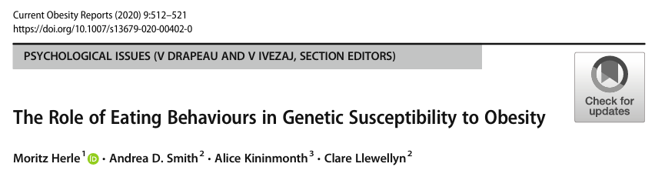
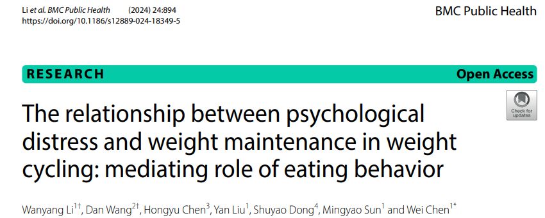
Various genetic, environmental, and metabolic components contribute to obesity. Eating behaviors stand out as pivotal in both the development and the perpetuation of the condition
Pathological eating behaviors do not merely pertain to the type or quantity of food consumed but rather to the pattern of eating, that becomes an attempt to alleviate psychological distress.
Eating provides temporary comfort from the internal unease while, however, exacerbates feelings of guilt, shame, and distress after the ingestion.
As a result, these eating patterns not only fuel the progression of obesity but also reflect the psychological and emotional challenges, further reinforcing the multifactorial nature of the disease

Slide 4
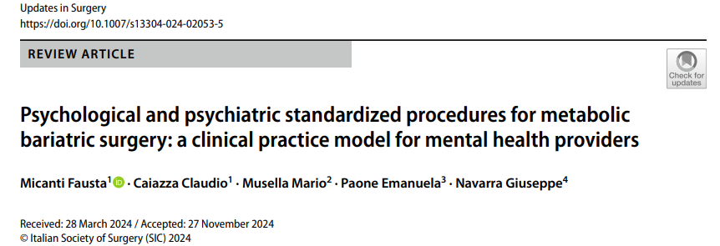

Pathological eating behaviors encompass
range of unhealthy food consumption
patterns that result from a dysfunctional
interaction between the emotional
regulation systems and hunger stimulus
recognition.
The Emotion-induce eating model
emphasizes that dysfunctional
emotional and cognitive processing might
contribute to the generation and
perpetuation of emotional eating (i.e.,
eating in response to emotion to cope wit
stress or negative feelings rather than
hunger stimuli), as a compensatory
behavior for the inability to withstand
intense emotional stimuli.

Slide 5
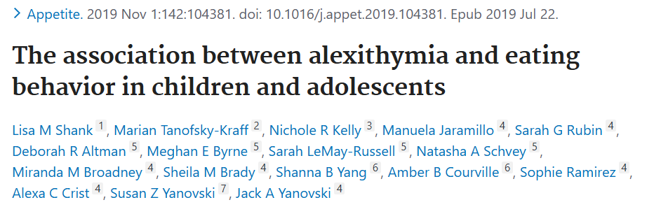

Individuals with pathological eating behaviors
expressed higher levels of alexithymia, emotional
dysregulation, impulsiveness and lack of interoceptive Awareness.
Alexithymia is a psychological construct characterized by difficulty identifying and describing body sensations and is linked to an altered prefrontal cortex (PFC) activity.
Individuals exhibiting high levels of alexithymia and
emotional dysregulation, are more likely to use food as a maladaptive coping mechanism rather than in response to hunger
Both alexithymia and emotional dysregulation correlate with a lack of interoceptive awareness, since they may contribute to the inaccurate perception of internal bodily cues.

Slide 6
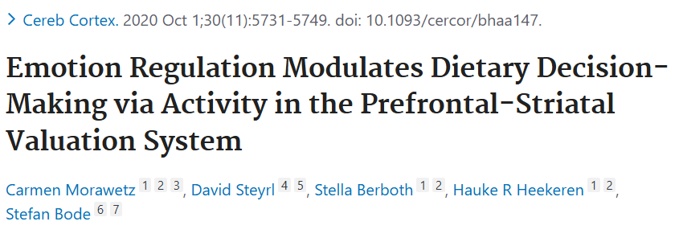
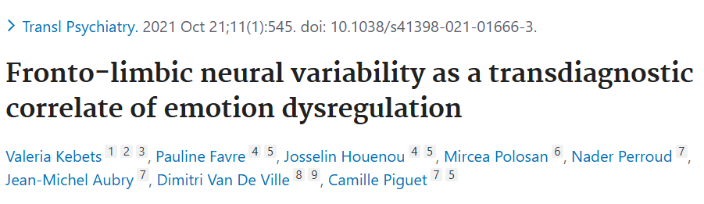
The emotional dysregulation from a neurobiological
perspective is linked to dysfunctions in the
frontolimbic network, including hyperactivity in
limbic regions responsible for emotional generation
and hypoactivity in the PFC, associated to goal
directed behavior and affect regulation.
Intense emotional responses are generated but not
effectively managed. Individuals can resort to food
as a way to cope with overwhelming emotional
experiences, as a way to get a temporary relief
from negative affect

Slide 7
Emotional
dysregulation
Binge
Sweeteating
Food Addiction
Grazing
Emotional dysregulation
binge
sweeteating
Food addiction
grazing

Slide 8
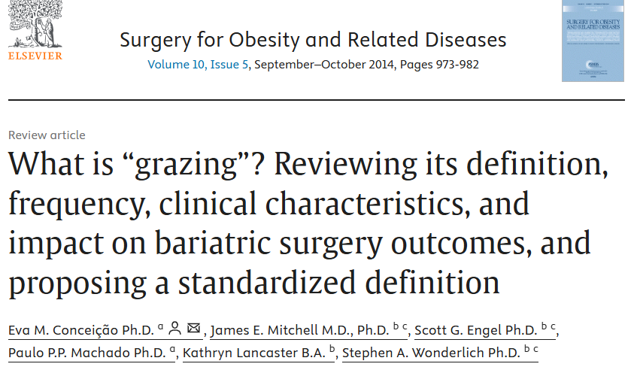
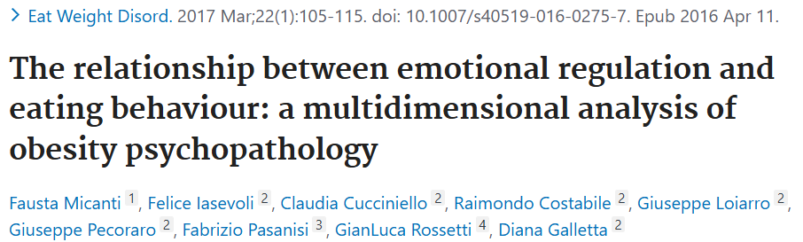
Grazing is now recognized as a maladaptive
eating behavior as sweet eating, binge and food
addiction.
It is defined as the unstructured repetitive eating
of small amounts of food (both salty and
sweet)over an extended period of time.
Grazing presents an increase in the CF and MF
factors but not in the NpF. These data are
consistent with the hypothesis that Motor
impulsiveness correlates much more with external
eating rather than with the response to internal
cues such as craving .
Data suggest why obese subjects with grazing
behavior have a great consumption of unhealthy
food in a determined period of time and have the
sensation of loss of control, but really they do not
lose it.

Slide 9
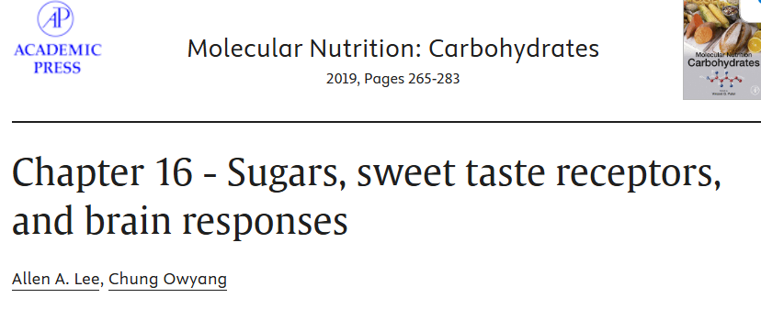
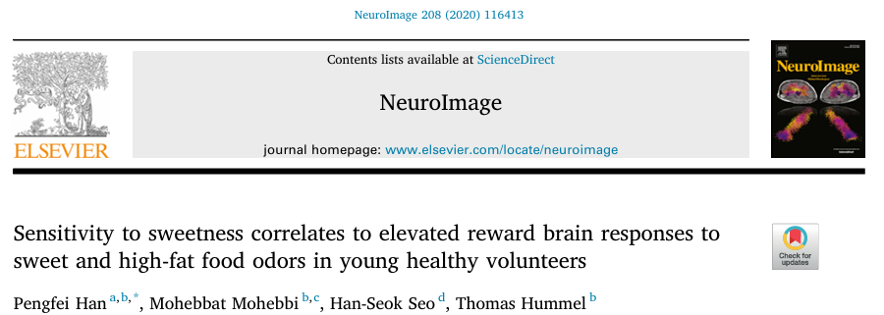
Sweeteating is usually characterized by overeating of
highly caloric sweet foods. The prevalent sugar food
intake activate di Edonic liking and food reward
empowering the action of NPY/AGPR in the
Hypothalamus.
Sugar is considered a powerful activator of mesolimbic
dopaminergic pathway giving signall to OCF and
determining addiction.
Recent studies show that there is a correlation between
sensitivity to sweetness and high-fat food odors and brain
response
The exposition produces greater brain-activations in the
gustatory and reward regions. It is shown a higher level
of activation in the frontal inferior operculum in response
to sweet vs. savory food odors, and stronger insular
activations to high fat vs. low-fat food odors.

Slide 10
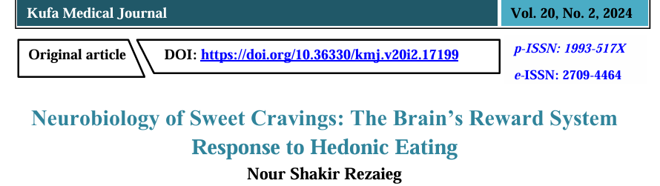
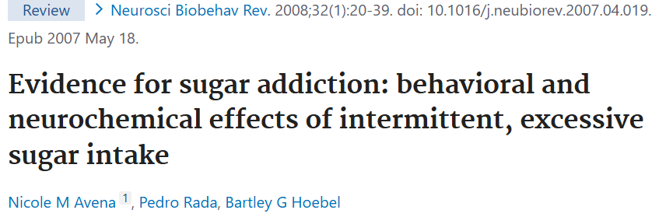
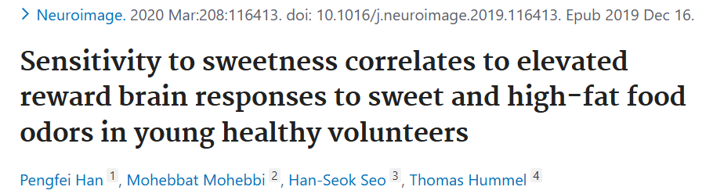
Individual sweetness sensitivity was positively associated with activation of the insula in response to chocolate and odor, suggesting an overlap of neural responses to food odor with high sugar and fat
content.

Slide 11
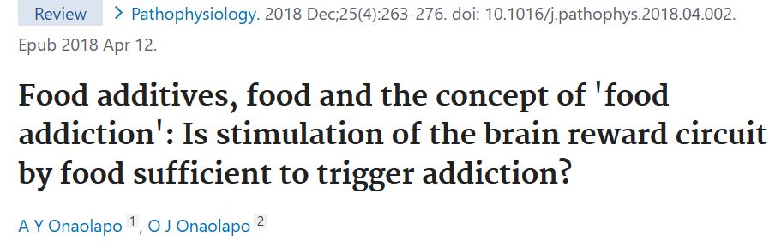
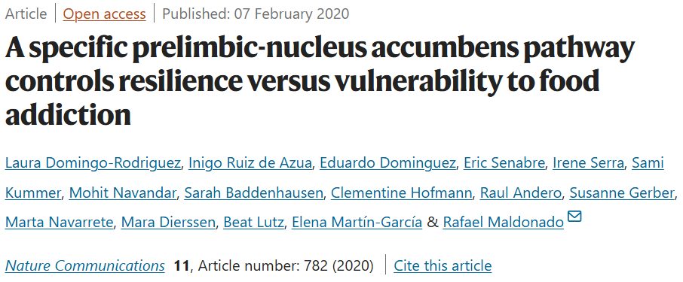
Food addiction is conceptualized through the
neurobiological reward system, such as other
addictions, since highly palatable foods
(especially those rich in sugar, fat and salt) ca
engage the mesolimbic dopamine pathway,
which originates in the ventral tegmental area
(VTA), a critical component of the reward
system .
Dopaminergic neurons project to the nucleus
accumbens (NAc), as well as regions like the
amygdala and prefrontal cortex, which
collectively encode the hedonic value of food
facilitate learning of reward-associated cues,
and modulate food-seeking behavior.

Slide 12

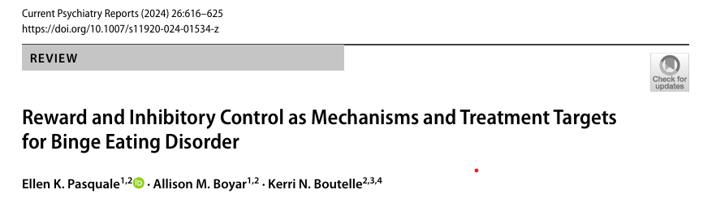
Food addiction shares behavioral and neurobiological parallels with substance use disorders, including loss of control, craving, and continued consumption despite distress and significant impairment.
The prevalence of a food addiction diagnosis was markedly higher among individuals with binge eating (68.4 %) and grazing (54.8 %) compared to those without pathological eating behaviors (17.2 %), highlighting the importance of the addictive component in eating behaviors .
Modern diets feature a growing prevalence o
hyperpalatable foods that are designed to intentionally
improve flavor to stimulate reward and promote
overconsumption since they trigger heightened
dopaminergic responses in the brain, similar to substanc
of abuse, reinforcing pathological eating behaviors and
potentially contributing to the worldwide rise in obesity and
metabolic disorders

Slide 13
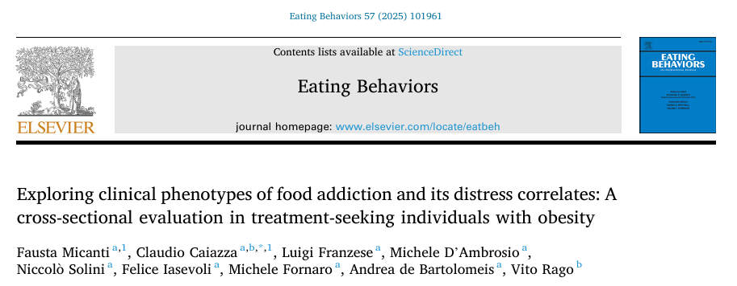
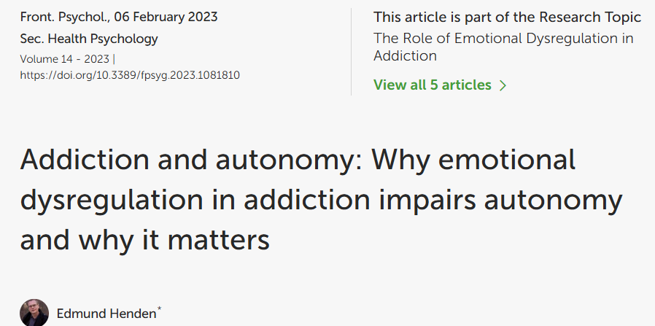
Individuals with food addiction exhibited significantly
Higher levels of emotional dysregulation across all
subscales of the Difficulties in Emotion Regulation
Scale (DERS).
These findings are consistent with prior research
Linking poor emotional regulation to pathological
Eating behavior suggesting that emotional
dysregulation may lead to compulsive food-seeking
as a pathological coping mechanism, where
impulsivity overrides rational control driving loss-of
control pattern that closely mirror the compulsive
cycles observed in substance addictions

Slide 14
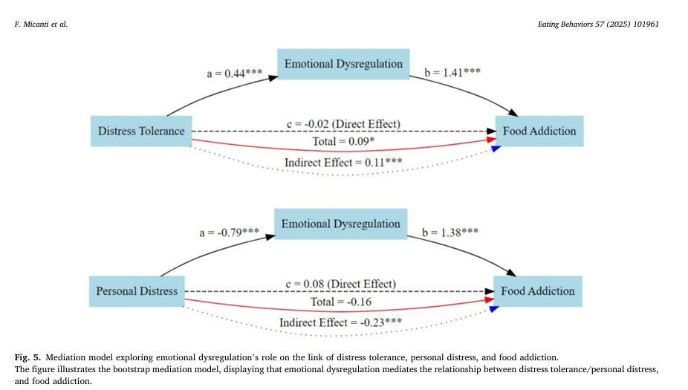
Micanti F, Caiazza C, Franzese L, D'Ambrosio M, Solini N et (2025) Exploring clinical phenotypes of food addiction and its distress correlates: A cross-sectional evaluation in treatment-seeking individuals with obesity. Eat Behav mar 4:57 101961

Slide 15
The identification of individuals with significant addictive-like behavior may help complement the multidimensional approach to obesity management with tailored interventions.
The association between pathological eating behaviors (i.e., binge eating and grazing) and a food addiction diagnosis highlights the importance of evaluating these behaviors in clinical settings since the identification of an addictive component can allow the employment of specific interventions to address the underlying psychological drivers of pathological eating and food addiction, beyond the nutritional aspects.
Moreover, both binge eating and grazing have been associated with poor clinical outcomes following metabolic and bariatric surgery, including an increased risk of post-surgery eating disorders, insufficient weight loss, and weight regain. (Me

Slide 16
Thank you

